Slide 1

Microsoft Azure Well-Architected Framework Overview for AI
Notes:
<Key Point> : Welcome
● Why is being well-architected important?
● Overview: Microsoft Azure Well-Architected Framework
● Overcoming workload quality inhibitors
● Resources & Amplification

Slide 2
Microsoft Azure Well-Architected Framework
Architecture guidance and best practices, created for architects, developers and solution owners, to improve the quality of their workloads, based on 5 aligned and connected pillars
Cost Optimization | Operational Excellence | Performance Efficiency | Reliability | Security
https://aka.ms/architecture/framework
Notes:
<Key point>: Microsoft Azure Well-Architected Framework enables cloud solution success.
<Talking Points>
Well-architecting operationalizes Microsoft Azure Well-Architected Framework’s 5 principles : cost optimization, operational excellence, performance efficiency, and reliability.
Well-architecting also Designs, builds, and optimizes cloud solutions, using architectural guidance, assessments, and industry best practices.
Cost-Optimization: Design "pay-as-you-go" cost-effective workloads, aligned with business objectives/ROI, while maintaining a budget.
Operational Excellence: Design reliable, predictable, automated deployments, with monitoring, performance management, and extensive automated and manual testing from an infrastructure and application perspective.
Performance Efficiency: Lower maintenance costs, improve user experience, and increase agility by architecting solutions with scalability baked-in. Move to PaaS by default, to use built-in scaling functionality.
Resiliency: Scale out instead of scaling up with expensive hardware, and build reliability across deployments with resilient, HA applications, and failure mode analysis.
Security: Build with security by design--to provide confidentiality, integrity, and availability assurances against deliberate attacks and abuse of your valuable data and systems.
<Transition>: Now you have some idea about the foundational principles, let’s walk through some Best practices to drive workload quality.

Slide 3
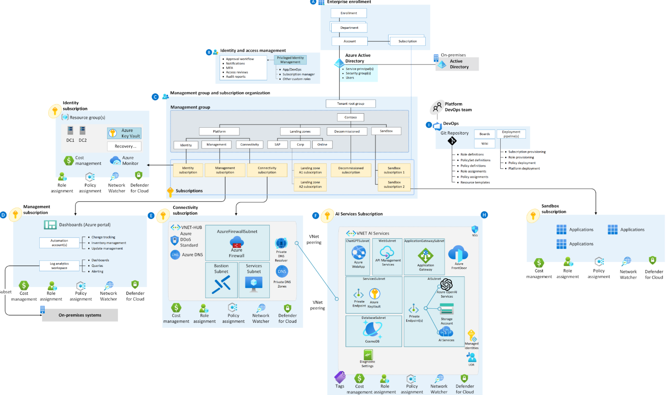
Azure Open AI Landing Zone
Notes:
<Key point>: AI Landing Zones can be complex
aka.ms/wellarchitected/learn
Azure Landing Zones provide a solid foundation for your cloud environment. When deploying complex AI services such as Azure OpenAI, using a Landing Zone approach helps you manage your resources in a structured, consistent manner, ensuring governance, compliance, and security are properly maintained.
The Azure OpenAI Landing Zone is a reference architecture that integrates a variety of services to create a seamless infrastructure for running OpenAI workloads.
Azure API Management (APIM)
Provides a unified API gateway for existing back-end services and APIs. It is used in the Landing Zone for managing and securing APIs used by OpenAI applications. APIM can be configured with an Application Gateway as a Web Application Firewall (WAF) to further enhance security. The WAF protects APIs from common web-based attacks like SQL injection or Cross-Site Scripting (XSS) and can be customized to suit specific needs.
Using APIM you can manage and implement policies such as rate throttling and quotas.
Azure Web Apps
Provides a fully managed platform for building and hosting web applications. It is used for hosting in a simple way web applications that consume OpenAI services in the Landing Zone.
Azure AI services
Offers AI services such as Azure Semantic Search that can be easily integrated into intelligent applications. OpenAI services, being part of Azure AI services, leverage this to deliver advanced language models.
Azure Managed Identities
Provides an identity for applications to use when connecting to resources. In the Landing Zone, it allows OpenAI applications to authenticate to any Azure service that supports Azure Active Directory authentication.
OpenAI supports Azure Active Directory (Azure AD) authentication with managed identities for Azure resources. Managed identities for Azure resources can authorize access to Azure AI services resources using Azure AD credentials from applications running in Azure virtual machines (VMs), function apps, virtual machine scale sets, and other services. By using managed identities for Azure resources together with Entra ID authentication, you can avoid storing credentials with your applications that run in the cloud.
Azure Application Gateway
An Application Gateway can function as a Web Application Firewall (WAF) providing protection against common web-based attacks. The WAF is configured with a custom set of rules that match the requirements of your OpenAI Applicartion to ensure only authorized access.
Azure Private DNS Zones
This service provides name resolution for VMs within a VNet and between VNets. This is important for efficient communication between services in Azure.
Azure Private DNS Resolver
In combination with Private DNS Zones, the Azure Private DNS Resolver helps ensure that name resolution for resources in your virtual network is secure and private. This service forwards DNS queries for specific domains to your own DNS servers, enhancing control over DNS results.

Slide 4
Azure Open AI Landing Zone
Azure API Management (APIM)
Provides a unified API gateway for existing back-end services and APIs. It is used in the Landing Zone for managing and securing APIs used by OpenAI applications. APIM can be configured with an Application Gateway as a Web Application Firewall (WAF) to further enhance security. The WAF protects APIs from common web-based attacks like SQL injection or Cross-Site Scripting (XSS) and can be customized to suit specific needs.
Using APIM you can manage and implement policies such as rate throttling and quotas.
Azure Web Apps
Provides a fully managed platform for building and hosting web applications. It is used for hosting in a simple way web applications that consume OpenAI services in the Landing Zone.
Azure AI services
Offers AI services such as Azure Semantic Search that can be easily integrated into intelligent applications. OpenAI services, being part of Azure AI services, leverage this to deliver advanced language models.
Azure Managed Identities
Provides an identity for applications to use when connecting to resources. In the Landing Zone, it allows OpenAI applications to authenticate to any Azure service that supports Azure Active Directory authentication.
OpenAI supports Azure Active Directory (Azure AD) authentication with managed identities for Azure resources. Managed identities for Azure resources can authorize access to Azure AI services resources using Azure AD credentials from applications running in Azure virtual machines (VMs), function apps, virtual machine scale sets, and other services. By using managed identities for Azure resources together with Entra ID authentication, you can avoid storing credentials with your applications that run in the cloud.
Azure Application Gateway
An Application Gateway can function as a Web Application Firewall (WAF) providing protection against common web-based attacks. The WAF is configured with a custom set of rules that match the requirements of your OpenAI Applicartion to ensure only authorized access.
Azure Private DNS Zones
This service provides name resolution for VMs within a VNet and between VNets. This is important for efficient communication between services in Azure.
Azure Private DNS Resolver
In combination with Private DNS Zones, the Azure Private DNS Resolver helps ensure that name resolution for resources in your virtual network is secure and private. This service forwards DNS queries for specific domains to your own DNS servers, enhancing control over DNS results.
Notes:
<Key point>: AI Landing Zones can be complex
aka.ms/wellarchitected/learn
Azure Landing Zones provide a solid foundation for your cloud environment. When deploying complex AI services such as Azure OpenAI, using a Landing Zone approach helps you manage your resources in a structured, consistent manner, ensuring governance, compliance, and security are properly maintained.
The Azure OpenAI Landing Zone is a reference architecture that integrates a variety of services to create a seamless infrastructure for running OpenAI workloads.
Azure API Management (APIM)
Provides a unified API gateway for existing back-end services and APIs. It is used in the Landing Zone for managing and securing APIs used by OpenAI applications. APIM can be configured with an Application Gateway as a Web Application Firewall (WAF) to further enhance security. The WAF protects APIs from common web-based attacks like SQL injection or Cross-Site Scripting (XSS) and can be customized to suit specific needs.
Using APIM you can manage and implement policies such as rate throttling and quotas.
Azure Web Apps
Provides a fully managed platform for building and hosting web applications. It is used for hosting in a simple way web applications that consume OpenAI services in the Landing Zone.
Azure AI services
Offers AI services such as Azure Semantic Search that can be easily integrated into intelligent applications. OpenAI services, being part of Azure AI services, leverage this to deliver advanced language models.
Azure Managed Identities
Provides an identity for applications to use when connecting to resources. In the Landing Zone, it allows OpenAI applications to authenticate to any Azure service that supports Azure Active Directory authentication.
OpenAI supports Azure Active Directory (Azure AD) authentication with managed identities for Azure resources. Managed identities for Azure resources can authorize access to Azure AI services resources using Azure AD credentials from applications running in Azure virtual machines (VMs), function apps, virtual machine scale sets, and other services. By using managed identities for Azure resources together with Entra ID authentication, you can avoid storing credentials with your applications that run in the cloud.
Azure Application Gateway
An Application Gateway can function as a Web Application Firewall (WAF) providing protection against common web-based attacks. The WAF is configured with a custom set of rules that match the requirements of your OpenAI Applicartion to ensure only authorized access.
Azure Private DNS Zones
This service provides name resolution for VMs within a VNet and between VNets. This is important for efficient communication between services in Azure.
Azure Private DNS Resolver
In combination with Private DNS Zones, the Azure Private DNS Resolver helps ensure that name resolution for resources in your virtual network is secure and private. This service forwards DNS queries for specific domains to your own DNS servers, enhancing control over DNS results.

Slide 5
Well-Architected at Microsoft
Partner &
Service Offers
Documentation
Azure Well-Architected Review
Cost Optimization
Security
Operational
Excellence
Reliability
Performance Efficiency
Reference
Architectures
Design Principles
Azure Advisor
Notes:
<Key point>: Well-Architected at Microsoft means achieving your business objectives with an ecosystem of best practices, assessments, and technical guidance that includes….
<Talking Points>
Azure Well-Architected Framework which enables you to achieve your business objectives, operationalizing how to design, build, and optimize cloud solutions.
Microsoft Azure Well-Architected Review provides and evaluates workloads with gap analysis. It identifies areas to focus your optimization efforts.
Reference Architectures help you build and deploy any workload to scale to meet your business needs.
Design principles are based on proven practices and design patterns from successful customer and partner deployments.
Microsoft Partner & Service Offers support to help you build effective cloud solutions.
<Transition>: Now you have some idea about the foundational ideas of what Microsoft Azure Well-Architected means, let’s dive into the framework itself…

Slide 6



Manage and optimize your AI costs with tools, offers, and guidance from Microsoft
Understand and forecast your costs |  | Cost optimize your workloads |  | Control your costs
Understand requirements i.e. data sizes, model training and inference needs to estimate costs. Design and understand your compute needs to forecast costs. Forecast costs for future investments with the Azure pricing and TCO calculator |  | Follow workload design best practices with the Azure Well-Architected Framework Configure training clusters with autoscaling, quotas and termination policies. Use Databricks Runtime for ML to provision optimized cluster. Use autoscaling and cost optimizer to calibrate cluster usage. |  | Utilize Cost Alerts to track and monitor AML Costs. Use Azure Cost Management and Billing to monitor Databricks costs. Monitor usage using cluster pool and workspace tags.
Learn more: Cost optimization - Learn | Microsoft Docs
Notes:
We’d like to conduct an engagement to help you manage and optimize your Azure costs and become more efficient with your Azure footprint. Cost optimization is now, more important than ever.
The purpose of this engagement is to help answer key questions we hear frequently from customers like you:
Why is my bill so high?
Where am I spending the most?
I was told the cloud was going to be cheaper, what happened?
Can I move to PaaS or modernize to reduce costs?
How do I get my organization to think differently so “cost awareness” is part of their DNA?
How do I provide visibility to my business units on their spending?
The goal is to help you become more efficient so you can be more successful in the cloud and ultimately choose the cloud for more of your workloads. The three buckets of areas on the screen are where we’ll focus. First, understanding your costs. Then cost optimizing your workloads. And finally, putting practices in place to control your costs going forward. Here are some of the tactical things we’ll end up doing together, if you agree to proceed with us:
Right sizing your environment
Identifying unused/”orphaned” resources
Getting more density with your compute
Identifying Reservation, Hybrid Benefit, and Spot VM opportunities
Identifying workloads that can move up the Azure stack (PaaS and SaaS)
• Agile and Accurate Processes: Build, deploy and maintain workloads with DevOps mindset and procedures, to integrate all parts of the development process and reduce dependency from manual workloads.
• Focused and assertive application monitoring: Have visibility of fundamental infrastructure and deep application data to ensure appropriate management of the workload environment.
• Continuous Improvement: Create and improve workloads with structured testing to mitigate risks and improve environment consistency between development and production stages.

Slide 7


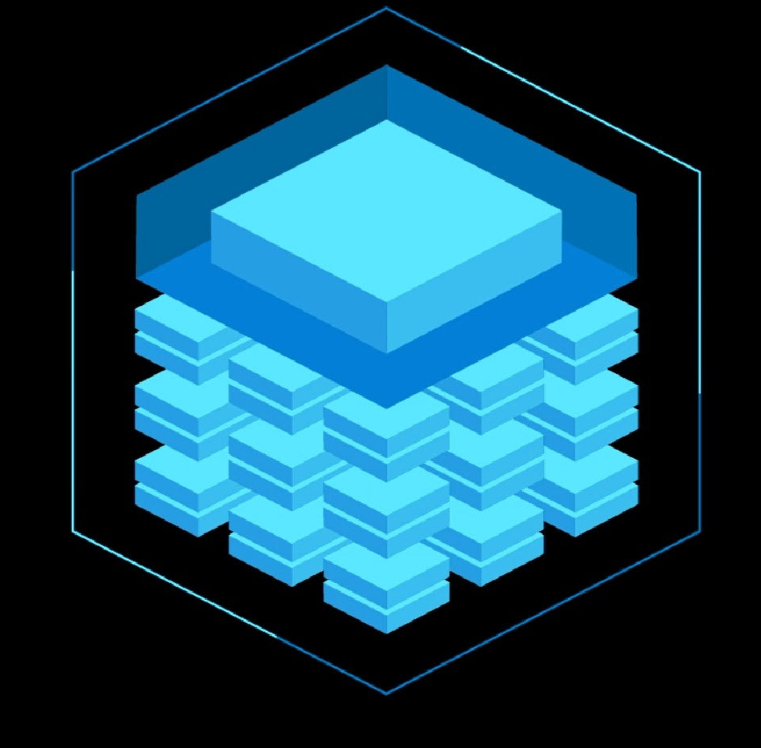
Design cloud workloads able to adapt to changes and maintain performance levels
Performance- What
Performance- Why
Performance- When
Performance- How
Select High Performing Compute Targets |  | Analyzing Metrics of your workloads |  | Cluster Management in Azure Databricks
Use compute instances as your fully configured and managed development environment for Data Scientists Select Azure Machine Learning compute cluster with multi-node scaling capabilities Use production grade model deployment with Azure Kubernetes Service cluster |  | Follow best performance practices with the Azure Well-Architected Framework Analyze performance metrics with Azure Metrics Explorer f Use Using Azure Monitor Log Analytics to understand diagnostic configuration |  | Utilize GPU-enabled instances, High Concurrency or Single Node Clusters Use Cluster automation to start or terminate clusters Use Autoscaling by Azure Databricks choosing the appropriate number of workers required
Learn more: Azure Machine Learning - ML as a Service | Microsoft Azure

Slide 8


Building Reliable Systems is a Shared Responsibility
Follow Reliable AI App Principles |  | Build for Reliablity |  | Reliability Standards with Azure Databricks
Resilient and recover gracefully from failures Highly available and run as designed in a healthy state with no significant downtime Determine how much downtime is acceptable, the potential cost to your business, and which functions are necessary during a recovery |  | Define requirements Use AI architectural best practices Test with simulations and forced failovers Deploy the AI application consistently Monitor AI application health Respond to failures and disasters |  | Utilize Acid Transactions, Snapshot Isolation, Schema Enforcement, Checkpointing to support Data Reliability Use ML Runtime Optimizations for reliable and secure distribution of open source ML frameworks
Learn more: Overview of the reliability pillar - Azure Architecture Center | Microsoft Docs

Slide 9
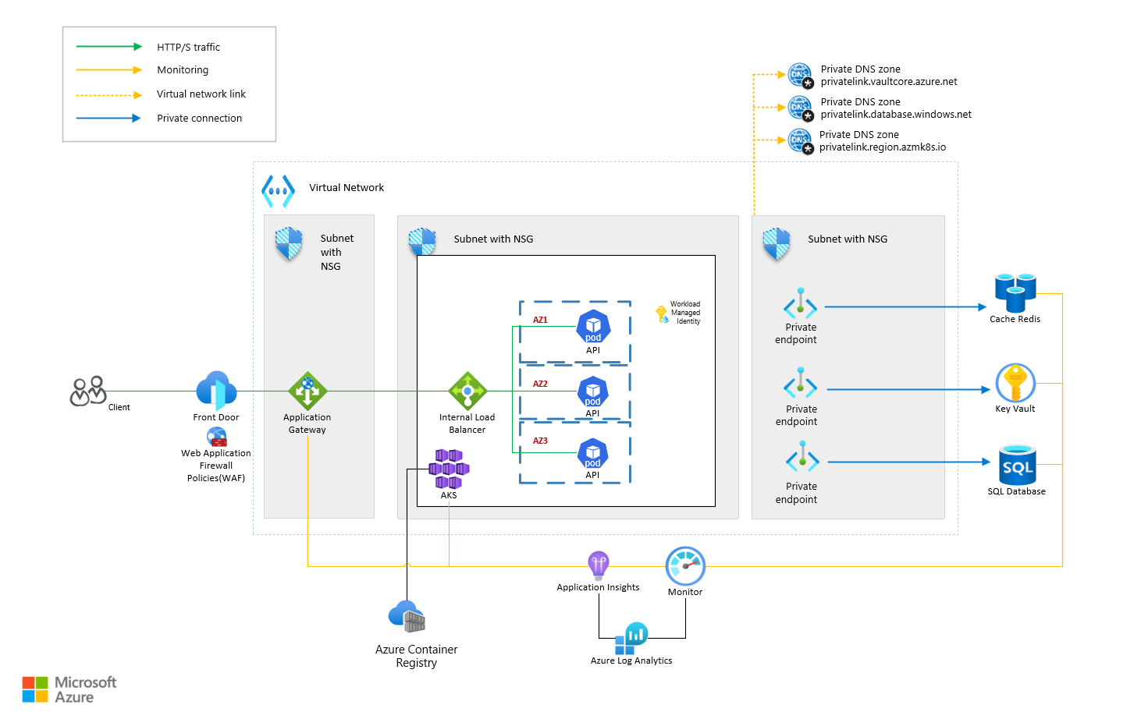
Availability Zone Resiliency
Notes:
<Key point>: AI Landing Zones can be complex
Availability Zone Resiliency on Ecommerce Reference Application | Microsoft Community Hub
The Resilient Ecommerce Reference Application is a synthetic workload that mirrors a simple, bare-bones, e-commerce platform. The purpose of it is to demonstrate how to use Azure Resiliency best practices to achieve availability during zonal outages or components outages.
The application has been tested for resiliency during simulated zonal outages and has performed as expected, keeping a high availability of the service with minimal impact to end users. Currently, it is being used by internal Microsoft teams for regression testing and new region buildouts, providing valuable telemetry to Azure service owners with regards to availability, recovery, service behavior and end user experience.
The app is publicly available on github and can be used for educational purposes or as a starting point for developing new resilient applications.

Slide 10
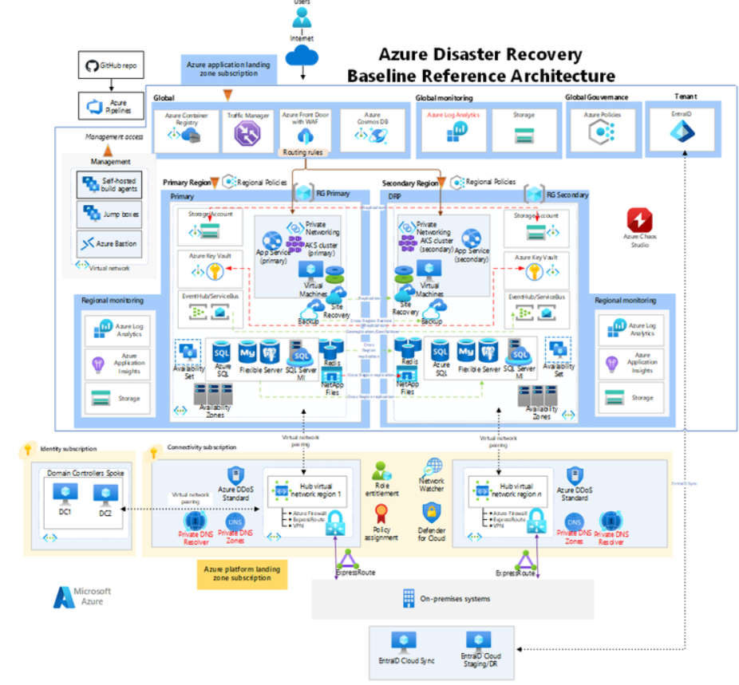
Reference Architecture for Reliability
Notes:
<Key point>: AI Landing Zones can be complex
Reliability in the cloud isn't just about having the right tools and services; it's about weaving those elements into an architecture that inherently embodies resilience and fault tolerance. A strategic approach towards crafting a reliable Azure architecture requires a holistic view that spans compute, storage, database, and networking resources.
To illustrate, let's delve into a reference architecture that showcases Azure's reliability principles in action. This architecture demonstrates how various Azure services interconnect to establish a dependable cloud infrastructure, ensuring seamless, continuous operations.

Slide 11



Build and manage proactively secured workloads
Build on Secure Foundation |  | Proactively stay secure with controls |  | Control your access
Use Azure policies to allow/enforce specific configurations Adhere to responsible AI principles build trustworthy AI solutions |  | Secure your environment with VNET and Private link Protect data using encryption on transit and rest Use homomorphic encryption to work with encrypted data Use differential privacy preserve privacy of data |  | Control access using advance Role based access control Use firewall to restrict inbound and outbound traffic Use managed identities for access control
Learn more: Security - Learn | Microsoft Docs
Notes:
We’d like to conduct an engagement to help you manage and optimize your Azure costs and become more efficient with your Azure footprint. Cost optimization is now, more important than ever.
The purpose of this engagement is to help answer key questions we hear frequently from customers like you:
Why is my bill so high?
Where am I spending the most?
I was told the cloud was going to be cheaper, what happened?
Can I move to PaaS or modernize to reduce costs?
How do I get my organization to think differently so “cost awareness” is part of their DNA?
How do I provide visibility to my business units on their spending?
The goal is to help you become more efficient so you can be more successful in the cloud and ultimately choose the cloud for more of your workloads. The three buckets of areas on the screen are where we’ll focus. First, understanding your costs. Then cost optimizing your workloads. And finally, putting practices in place to control your costs going forward. Here are some of the tactical things we’ll end up doing together, if you agree to proceed with us:
Right sizing your environment
Identifying unused/”orphaned” resources
Getting more density with your compute
Identifying Reservation, Hybrid Benefit, and Spot VM opportunities
Identifying workloads that can move up the Azure stack (PaaS and SaaS)

Slide 12
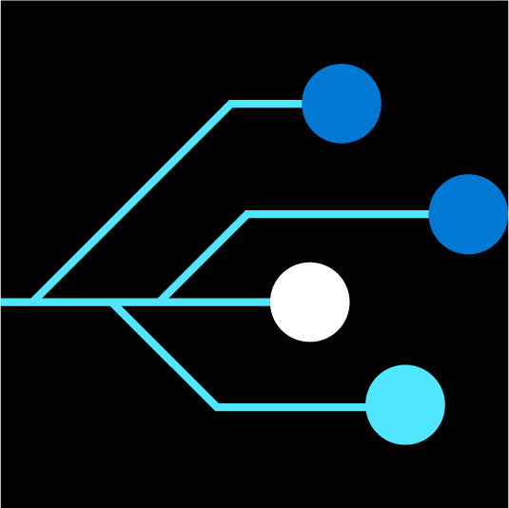
Architect & optimize workloads for success
Take assessment
Microsoft Azure Well-Architected Review
Read Documentation
Well-Architected Framework
Complete Training
Well-Architected Learn module
Review Design Principles
Well-Architected design patterns
Browse Reference Architectures
Azure Architectures
Notes:
<Key point>:What resources are available to guide you in designing and building your cloud solutions? Here are some next steps:
<Talking Points>
Technical documentation, assessments
Well-Architected Learn module
Cloud agnostic design patterns for building reliable, scalable, secure applications
Guidance for architecting solutions on Azure with established patterns and practices
Help for engaging Microsoft Partners
How to engage Microsoft Consulting Partners
<Transition>: Thank you

Slide 13
Thank you!
Notes:
<Key Point>: Thank you

